Slide 1
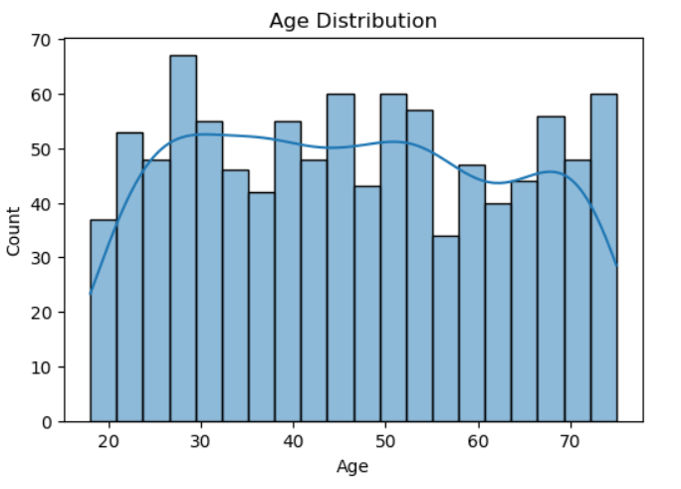
Exploratory Data Analysis (EDA)
Most customers fall between ages 25 and 45, indicating a younger demographic base.
There is a gradual decline in customer count beyond age 50, suggesting fewer older customers in the dataset.
The KDE curve provides a smooth estimate of the probability density, confirming that the distribution is slightly right-skewed.

Slide 2
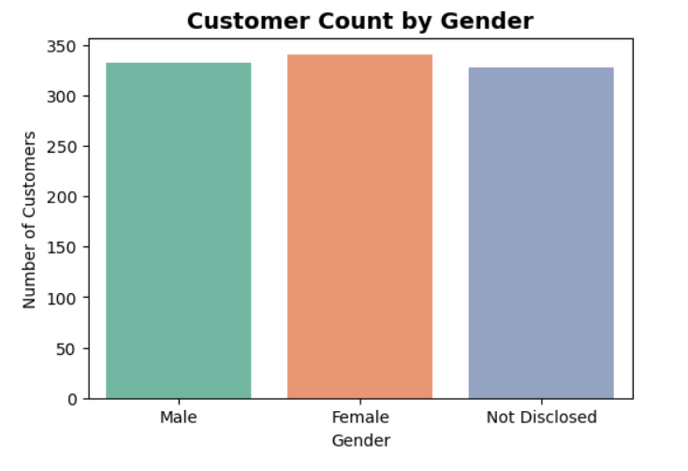
Customer Count by Gender
The distribution is relatively balanced among Male, Female, and Not Disclosed groups, each contributing close to one-third of the customer base.
This balance suggests that the dataset is diverse and not heavily skewed toward one gender.- The presence of a significant "Not Disclosed" group highlights that some customers prefer not to reveal gender information, which is important for respecting privacy in segmentation.

Slide 3
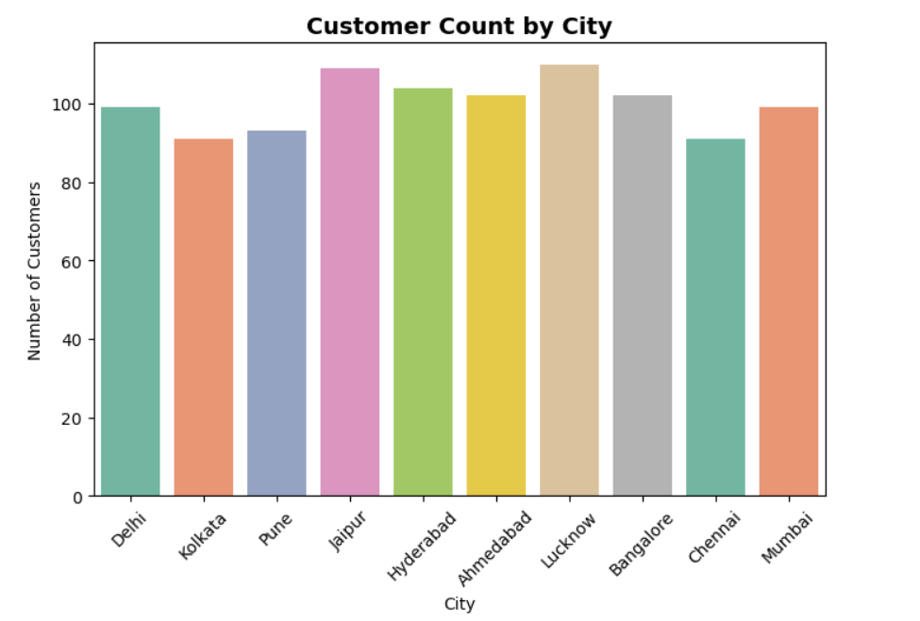
Customer Count by City
**Insights:** - Each variable is perfectly correlated with itself (correlation = 1). - The correlation between **Age** and **NumChildren** is **-0.04**, indicating a very weak negative relationship. - This suggests that as age increases, the number of children tends to decrease slightly, but the relationship is not strong enough to be statistically meaningful.
**Insights:** - Each variable is perfectly correlated with itself (correlation = 1). - The correlation between **Age** and **NumChildren** is **-0.04**, indicating a very weak negative relationship. - This suggests that as age increases, the number of children tends to decrease slightly, but the relationship is not strong enough to be statistically meaningful.
**Insights:** - Each variable is perfectly correlated with itself (correlation = 1). - The correlation between **Age** and **NumChildren** is **-0.04**, indicating a very weak negative relationship. - This suggests that as age increases, the number of children tends to decrease slightly, but the relationship is not strong enough to be statistically meaningful.
Jaipur has the highest customer count, slightly above 110, indicating strong market presence in that region.
Kolkata and Chennai have the lowest counts, around 90, suggesting smaller customer bases compared to other cities.
Other cities such as Delhi, Pune, Hyderabad, and Mumbai show moderate representation, each contributing significantly to the overall dataset.

Slide 4
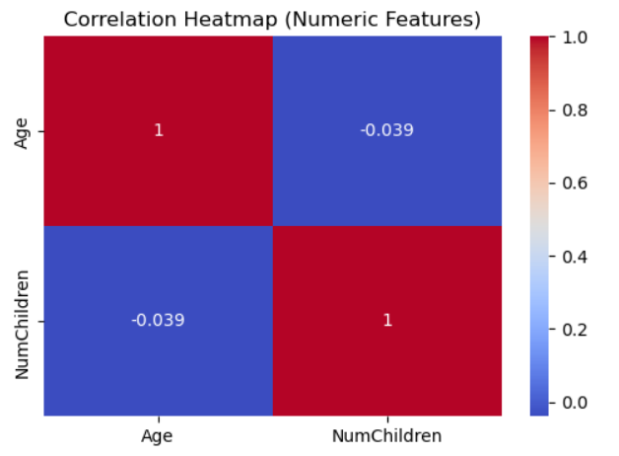
Correlation Heatmap
Each variable is perfectly correlated with itself (correlation = 1).
The correlation between Age and NumChildren is -0.04, indicating a very weak negative relationship.
This suggests that as age increases, the number of children tends to decrease slightly, but the relationship is not strong enough to be statistically meaningful.

Slide 5
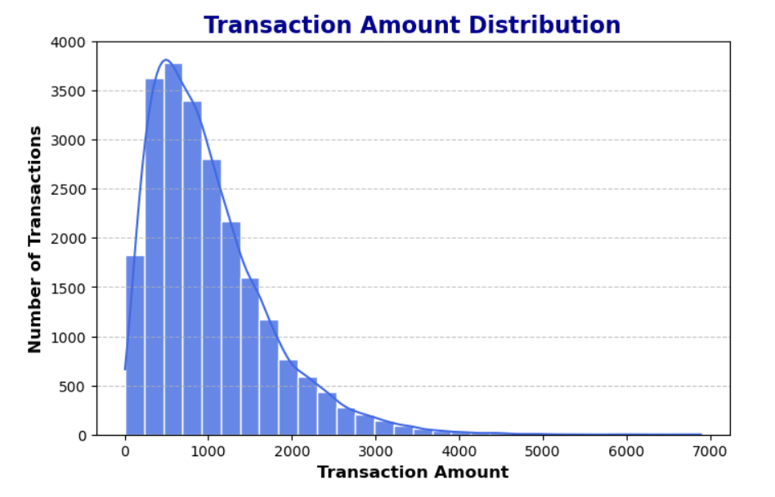
Transaction Amount Distribution
The distribution is right-skewed: most transactions are below 1,000, while a few extend up to ~7,000.
A large cluster of transactions falls between 500–1,300, indicating typical spending behavior.
High-value outliers exist, but they are rare compared to the bulk of transactions.

Slide 6
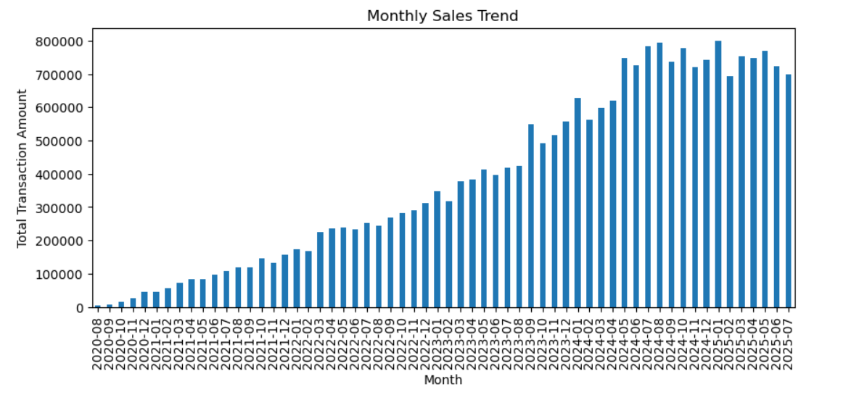
Monthly Sales Trend
Overall Growth: There is a clear upward trend in monthly sales, reflecting consistent business growth over the 5-year period.
Seasonality: Fluctuations are visible around 2024–2025, suggesting possible seasonal effects or promotional campaigns driving spikes in sales.
Stability: From 2020 through 2023, growth appears steady and gradual, indicating a stable customer base and reliable transaction flow.
Acceleration: The higher peaks in later years highlight increased customer engagement and potentially larger transaction values.

Slide 7
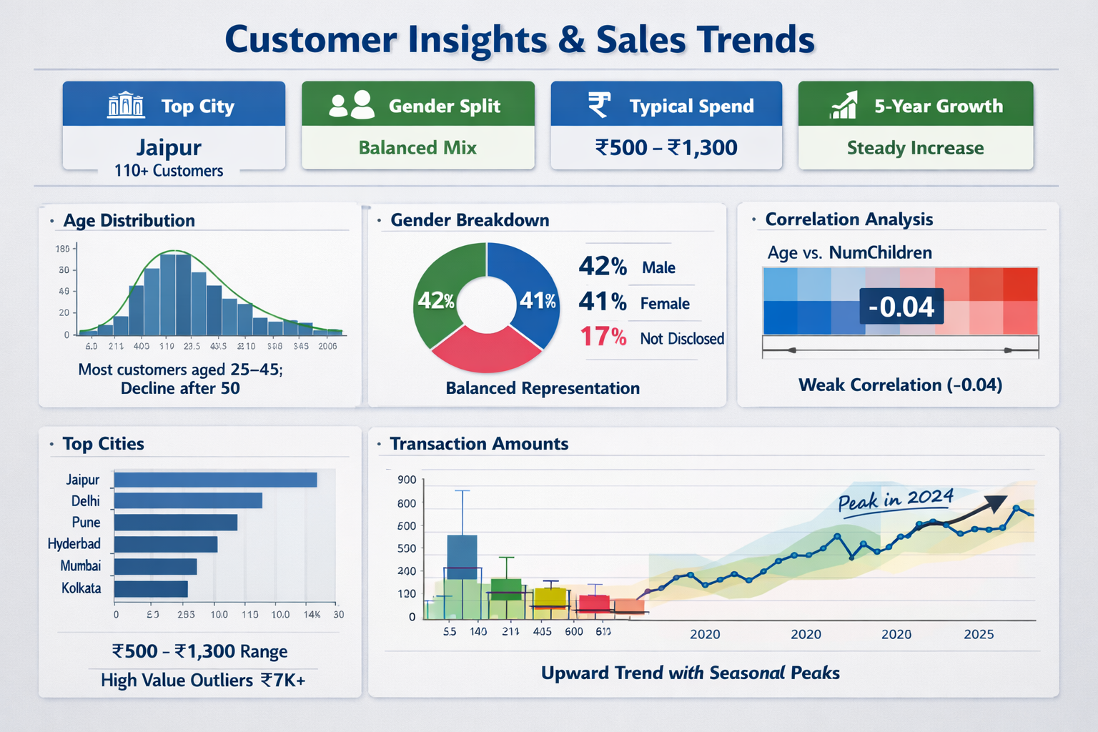
Customers Insights & Sales Trends
Top City: Jaipur leads with over 110 customers, indicating strong regional engagement.
Gender Split: Balanced representation between male and female customers, showing inclusive market reach.
Typical Spend: Most customers spend between ₹500–₹1,300, suggesting mid-range purchasing behavior.
5-Year Growth: Steady upward trend, reflecting consistent business expansion.

Slide 8
RFM visualizations

Slide 9
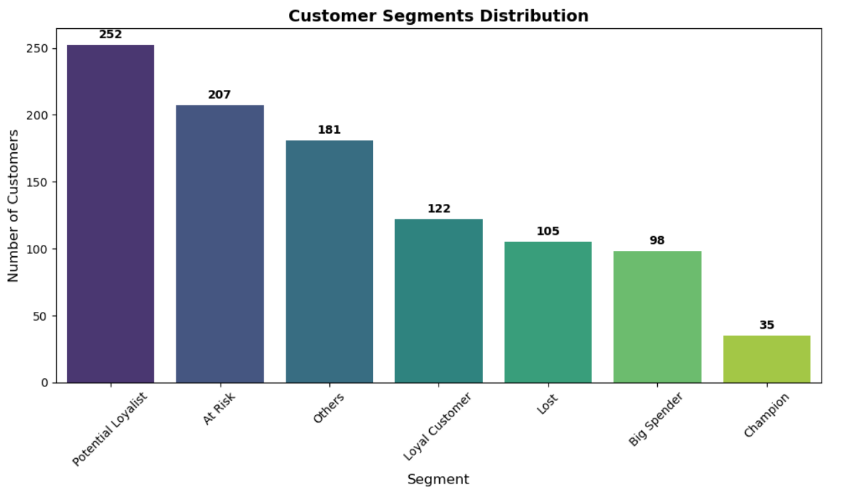
Count of customers per segment

Slide 10
Count of customers per segment
Potential Loyalists (252 customers) form the largest group, indicating many customers show promising buying behavior but need nurturing to become fully loyal.
At Risk (207 customers) is the second largest segment, highlighting a significant portion of customers who have reduced engagement and may churn if not reactivated.
Others (181 customers) represent a mixed group with moderate activity, requiring further profiling to design targeted strategies.
Loyal Customers (122 customers) demonstrate consistent purchasing patterns and should be rewarded to maintain retention.
Lost (105 customers) are inactive customers who may need win-back campaigns or can be deprioritized depending on business goals.
Big Spenders (98 customers) contribute high monetary value despite lower frequency, making them important for premium offers.
Champions (35 customers) are the most valuable segment, combining high recency, frequency, and monetary scores. They should be prioritized for loyalty programs and advocacy initiatives.
Insight: The distribution shows that while the business has a strong base of Potential Loyalists, the high count of At Risk customers signals a need for proactive engagement strategies. Focusing on converting Potential Loyalists into Loyal Customers and retaining Champions will maximize long-term revenue and customer lifetime value.

Slide 11
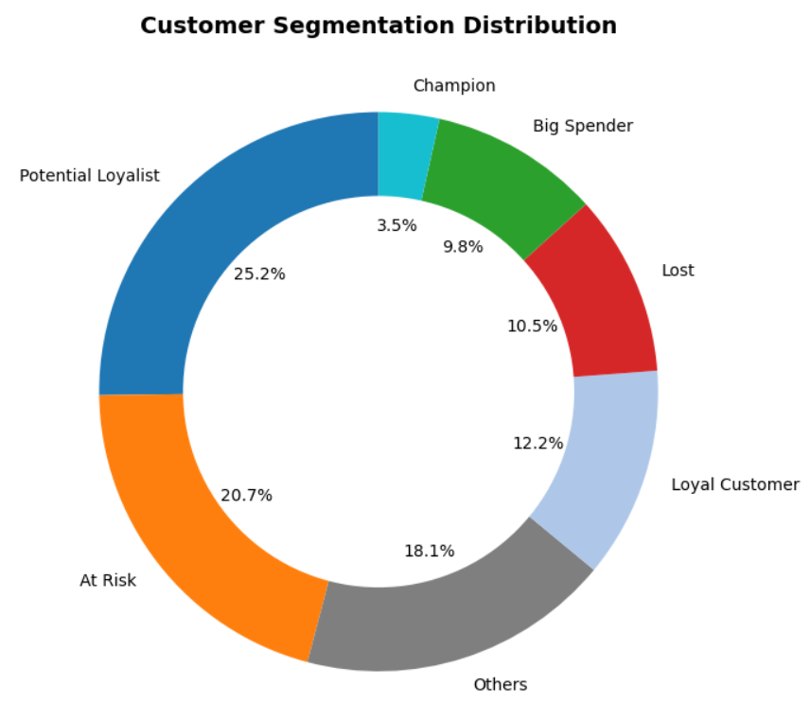
Customer Segmentation Distribution (Donut Chart Analysis)

Slide 12
Customer Segmentation Distribution (Donut Chart Analysis)
Potential Loyalists (25.2%) form the largest share, showing strong potential for conversion into loyal customers with targeted engagement.
At Risk (20.7%) is the second largest group, signaling a significant churn risk. These customers require reactivation campaigns to prevent revenue loss.
Others (18.1%) represent a mixed category with moderate engagement. Further profiling can help design tailored strategies.
Loyal Customers (12.2%) consistently engage with the business. They should be nurtured with rewards and retention programs.
Lost (10.5%) are inactive customers. Win-back campaigns may be attempted, but prioritization depends on ROI.
Big Spenders (9.8%) contribute high monetary value despite lower frequency. Premium offers and personalized experiences can maximize their lifetime value.
Champions (3.5%) are the most valuable customers, combining high recency, frequency, and monetary scores. They should be prioritized for loyalty programs, advocacy, and exclusive benefits.
Strategic Takeaway: The distribution highlights two critical priorities:
Retention — Address the large At Risk segment to reduce churn.
Growth — Convert Potential Loyalists into Loyal Customers to strengthen the core base.

Slide 13
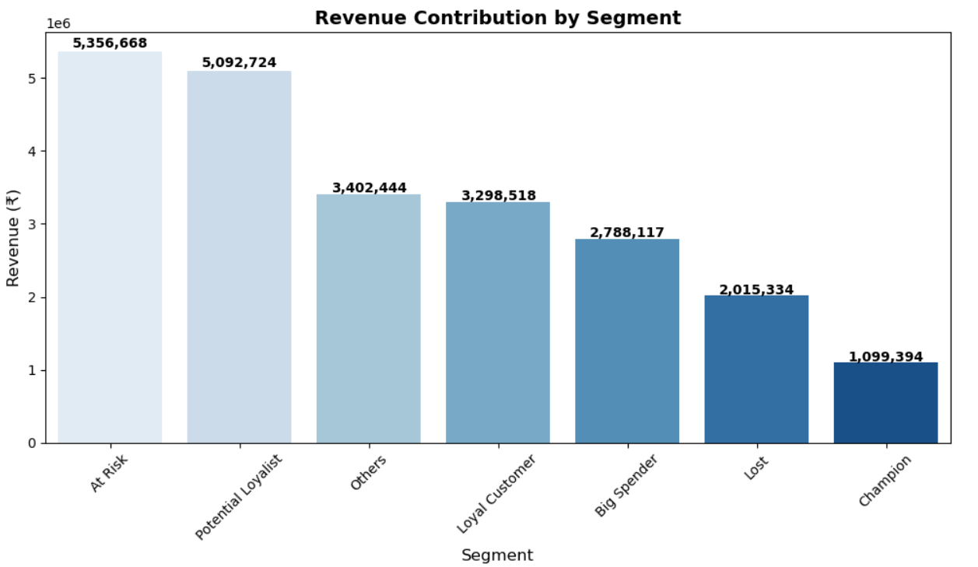
Revenue contribution per segment

Slide 14
Revenue contribution per segment
At Risk (₹5.36M) contributes the highest share of revenue, despite their declining engagement. This indicates that many high-value customers are at risk of churn, making retention efforts critical.
Potential Loyalists (₹5.09M) are the second-largest revenue drivers. With proper nurturing, they can be converted into Loyal Customers, strengthening the long-term revenue base.
Others (₹3.40M) and Loyal Customers (₹3.30M) contribute moderate revenue. Loyal Customers should be rewarded to maintain retention, while Others may need further profiling for targeted strategies.
Big Spenders (₹2.79M) generate significant revenue despite lower frequency. Personalized premium offers can maximize their lifetime value.
Lost (₹2.02M) still represent a notable revenue pool. Win-back campaigns may recover some value, though ROI should be carefully assessed.
Champions (₹1.10M), while the smallest group in count, remain strategically important due to their consistent high-value behavior. They should be prioritized for loyalty programs and advocacy initiatives.
Strategic Takeaway: The analysis shows that the business is heavily dependent on At Risk and Potential Loyalist segments for revenue. Immediate focus should be on retaining At Risk customers and converting Potential Loyalists into Loyal Customers. Meanwhile, nurturing Champions and Big Spenders ensures sustained profitability and brand advocacy.

Slide 15
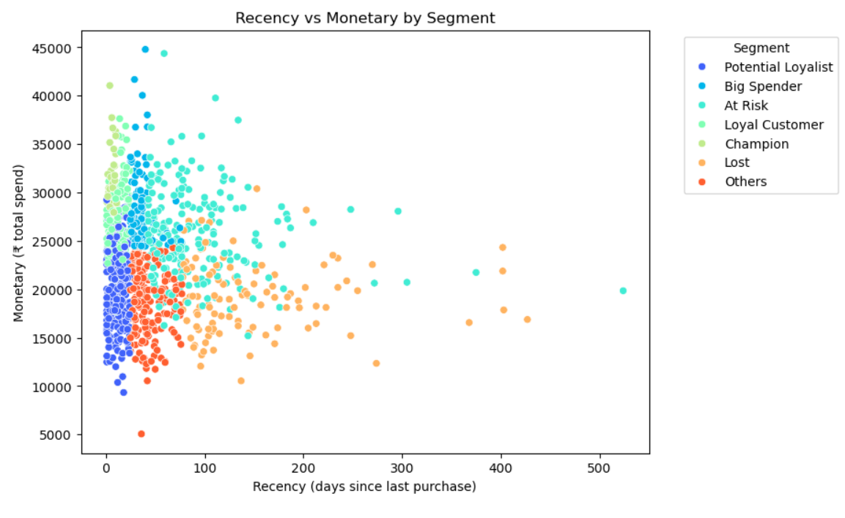
Scatter plot: Recency vs Monetary by Segment

Slide 16
Scatter plot: Recency vs Monetary by Segment
Champions → Low recency (recent buyers), high monetary. Best customers.
Loyal Customers → Moderate recency, steady monetary. Reliable revenue.
Potential Loyalists → Low recency but lower spend. Opportunity to nurture.
At Risk → High recency (haven’t purchased recently) but high monetary. Critical to re-engage.
Big Spenders → High monetary, variable recency. Need VIP treatment.
Lost → High recency, low monetary. Minimal ROI.
Others → Mixed profiles, scattered across the plot.
Strategic Takeaway: Customers with high spend but high recency (At Risk) are the most urgent to target, while Potential Loyalists represent the biggest growth opportunity.

Slide 17
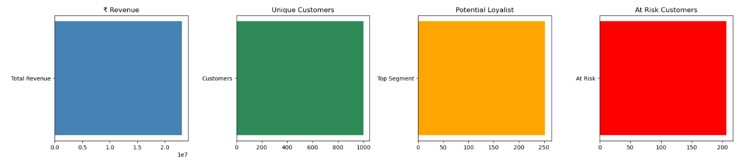
Dashboard-Style KPI Cards

Slide 18
Dashboard-Style KPI Cards
₹ Revenue (~20M) The company has generated strong overall revenue, reflecting healthy sales activity. This serves as the primary indicator of business scale and financial performance.
Unique Customers (~1,000) The customer base is sizable, providing a solid foundation for segmentation and targeted marketing. Maintaining engagement across this base is critical for sustained growth.
Potential Loyalists (~250 customers) This is the largest segment, representing customers with promising buying behavior. They are close to becoming Loyal Customers and should be nurtured with personalized offers and engagement strategies.
At Risk Customers (~200 customers) A significant portion of the customer base is at risk of churn. These customers contribute high revenue but show declining engagement, making retention campaigns essential to protect future earnings.
Strategic Takeaway: The KPIs highlight a balanced picture: strong revenue and a healthy customer base, but with clear opportunities and risks. The business should focus on converting Potential Loyalists into Loyal Customers to strengthen retention, while simultaneously re‑engaging At Risk customers to prevent revenue leakage. Together, these actions will maximize customer lifetime value and ensure sustainable growth.

Slide 19
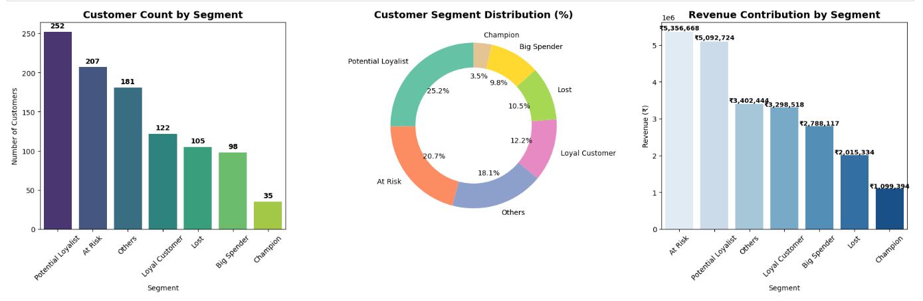
RFM visualizations

